Slide 1

HOSPITAL APPOINTMENT SYSTEM
SUBMITTED TO:Dr. Sushil Kamboj
SUBMITTED BY:Richa Rawat

Slide 2
Abstract
The project is of web designing using Html, Css, Bootstrap and JavaScript for frontend. The purpose of designing this website to is provide the online
Appointment for doctors and treatment. Patients can directly contact and make queries about your treatment and appointment for the availability of doctors. Patients can check the various services provided by the heath care center. The health care center provides the various department services like specialty in cardiology, neurology and eye care.
The project main aim is providing the online services to the patients so that they can easily take the appointment from specialist doctors and get rid from their diseases very easily in less time and it also saves the time.
Health care gallery is also present in website

Slide 3
Project Background:
Restaurant Booking is the system for manage the restaurant business. The main point of developing this system is to help restaurant administrator manage the restaurant business and help customer for online ordering and reserve table. The project is developing because; many restaurants have a lot difficult to manage the business such as customer ordering and reservation table. By using manual customer ordering is difficult to waiter keep the correct customer information and maybe loss the customer information. So, online restaurant management system will develop to help the restaurant administrator to manage restaurant management and for customer make their online ordering and reservation table. Other than that, this project is to upgrade the manual system and make the business easily to access and systematic.

Slide 4
Problem Statement:
Nowadays, many restaurants manage their business by manual especially take customer ordering. Today, restaurant waiter takes the customer ordering by manual system with using paper. This is problem for restaurant waiter the probability lost and duplicates customer information. Additionally, it would affect to reputation restaurant in operate management of ordering. hides, the restaurant waiter information also by manual system kept use paper and this is difficult for restaurant administrator to find waiter information, probability missing the paper and difficult to arrange the schedule. Sometimes, waiter information and customer information is important to restaurant administrator for reference in the future. Furthermore, restaurant side needs management in the section menu. This is the important to restaurant waiter to manage the menu. Besides this section is for customer viewer the menu that restaurant prepared and make their ordering. As a result, the current system (manual system) is not effective and efficient to use anymore because the current system cannot save, manage and monitor the restaurant waiter information, menu info, customer ordering info. and generate report well

Slide 5
Role of front-end languages for the web development
How Is Web Development Divided?
Web development is often separated into front-end development and back-end development. If you are working as a freelancer, you could need to complete both of these roles. If you are part of a larger team, you’ll probably just be focused on one aspect.
Front-End
Front-end development is based on programming languages which can include HTML, JavaScript, and CSS. When you research web development, you might find that developers favour a particular language and suggest that this one is the best. However, that’s not the case and the individual languages all have different roles to play. Which one you use will depend on the project that you are working on.
As a front-end developer, you’ll be focused on connecting the dots between design and the technology behind it. While web designers will focus on the visuals of a site, the web developer works to transform these designs. Key aspects include:
Layout
Buttons
Navigation
Internal links

Slide 6
Back-End
This refers to the server-side element of development. If you’re working as a back-end developer, then you won’t have any connection to the visuals or the design of the website. However, the role is just as important. You will need to update the website and make the right changes. It will also be necessary for you to constantly change the website is functioning as it should and remains effective.
Back-end developers are required to write code. This code is used to communicate information from the database to the browser. You do need to be familiar with the language front-end developers are using to ensure that this does work effectively. However, you will also need to understand other coding languages as well.
So, while front-end developers focus on the holistic side, back-end developers looking at whether the site is functioning correctly. Back-end languages can also be used to create dynamic sites.

Slide 7
PHP for the backend:
The PHP Hypertext Preprocessor (PHP) is a programming language that allows web developers to create dynamic content that interacts with databases. PHP is basically used for developing web based software applications. This tutorial helps you to build your base with PHP.
Why to Learn PHP?
PHP started out as a small open source project that evolved as more and more people found out how useful it was. Rasmus Lerdorf unleashed the first version of PHP way back in 1994.
PHP is a MUST for students and working professionals to become a great Software Engineer specially when they are working in Web Development Domain. I will list down some of the key advantages of learning PHP:
PHP is a recursive acronym for "PHP: Hypertext Preprocessor".
PHP is a server side scripting language that is embedded in HTML. It is used to manage dynamic content, databases, session tracking, even build entire e-commerce sites.

Slide 8
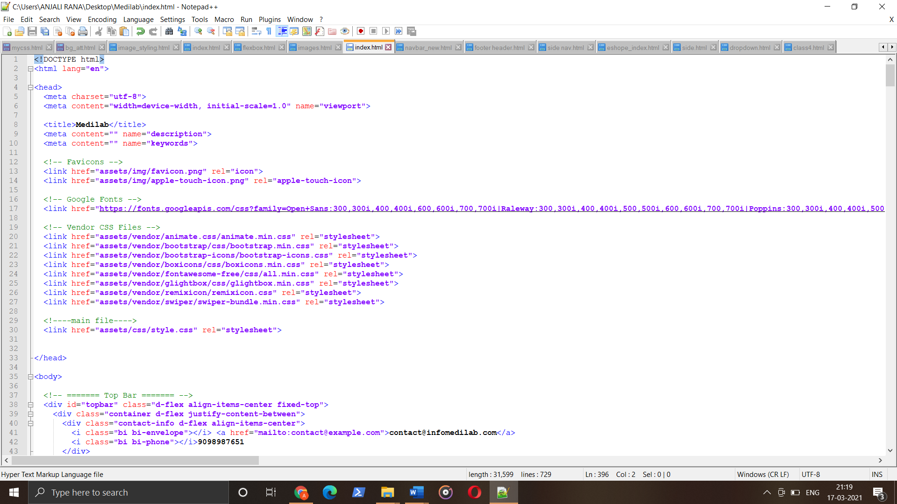

Slide 9
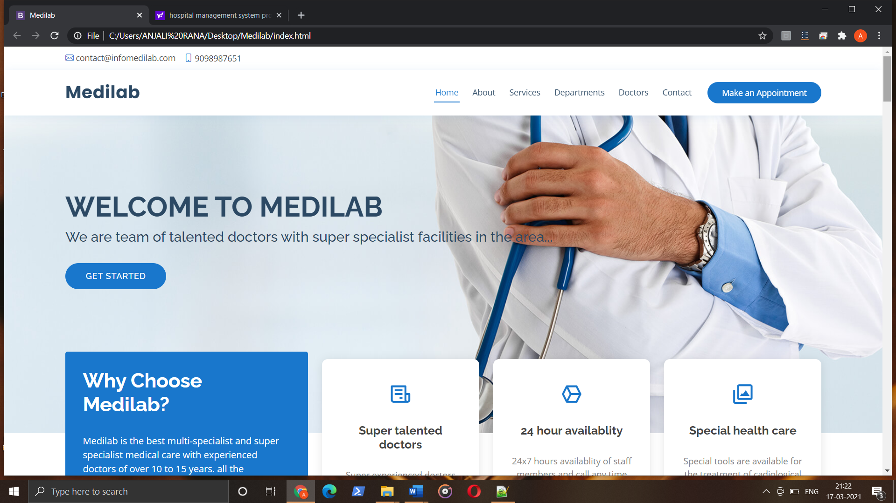
Screenshots

Slide 10
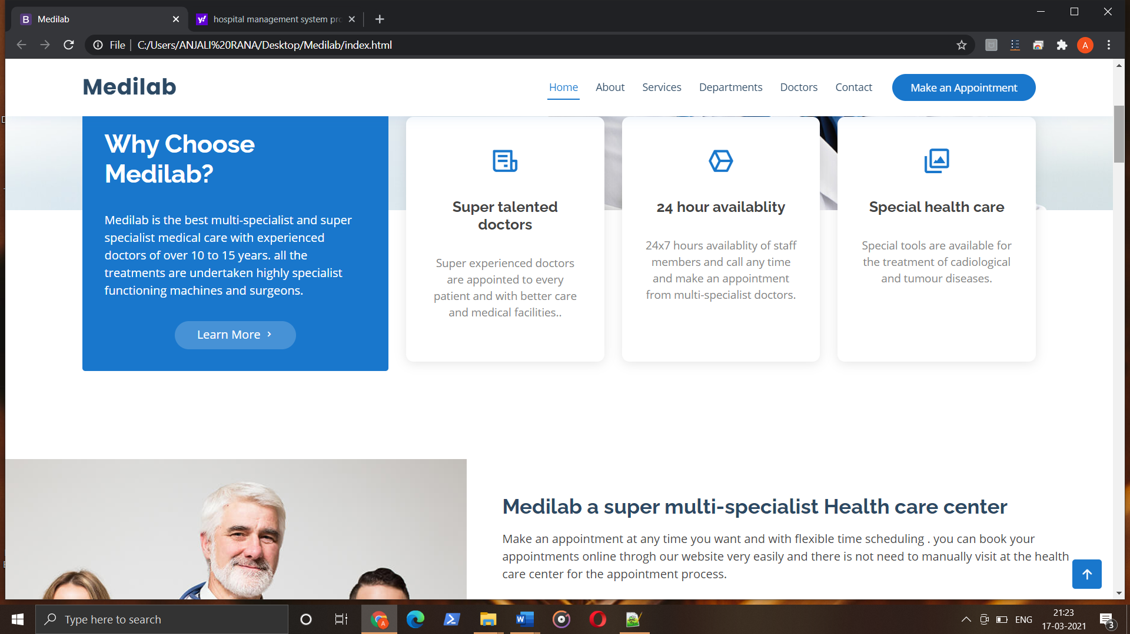

Slide 11
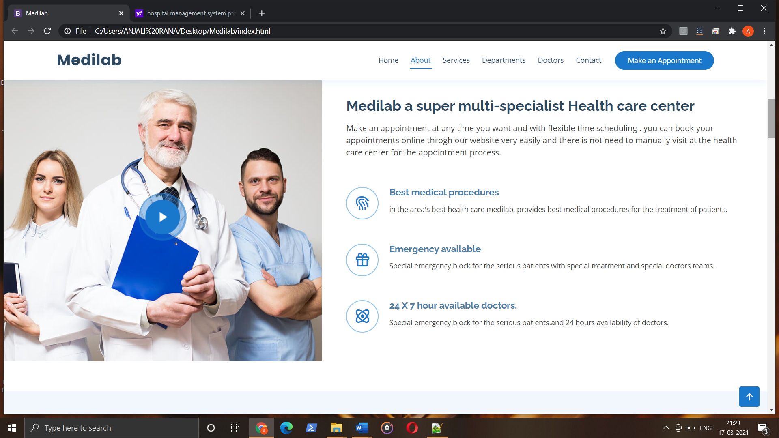

Slide 12
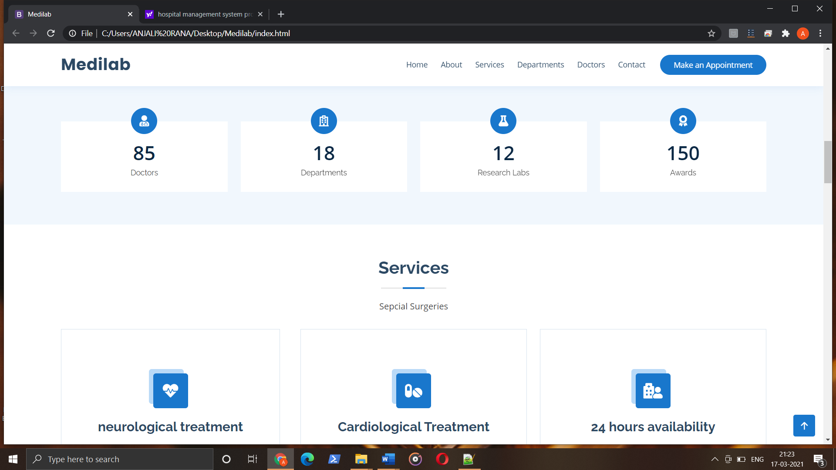

Slide 13
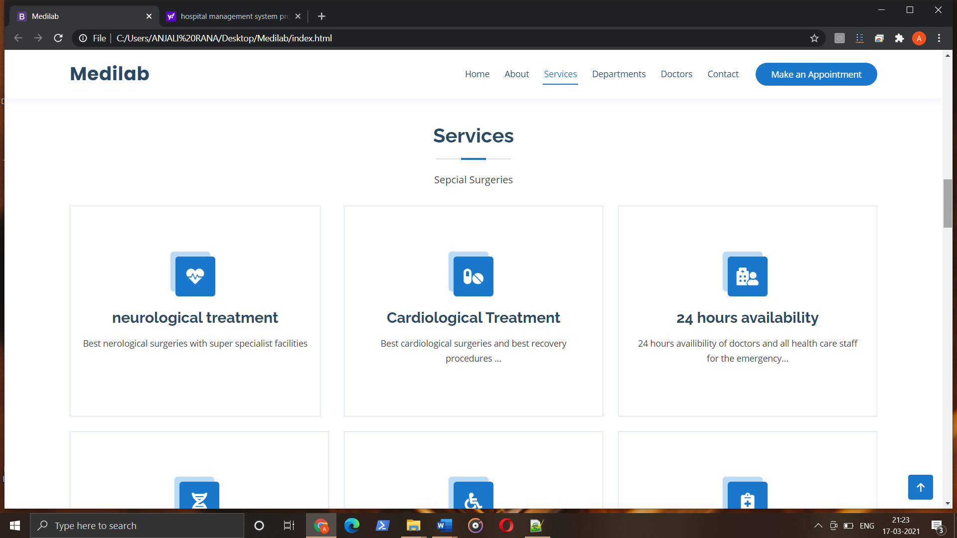

Slide 14
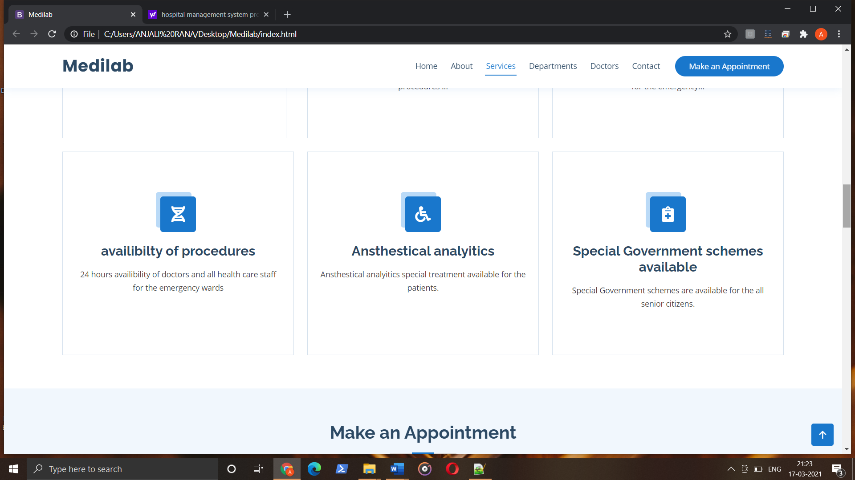

Slide 15
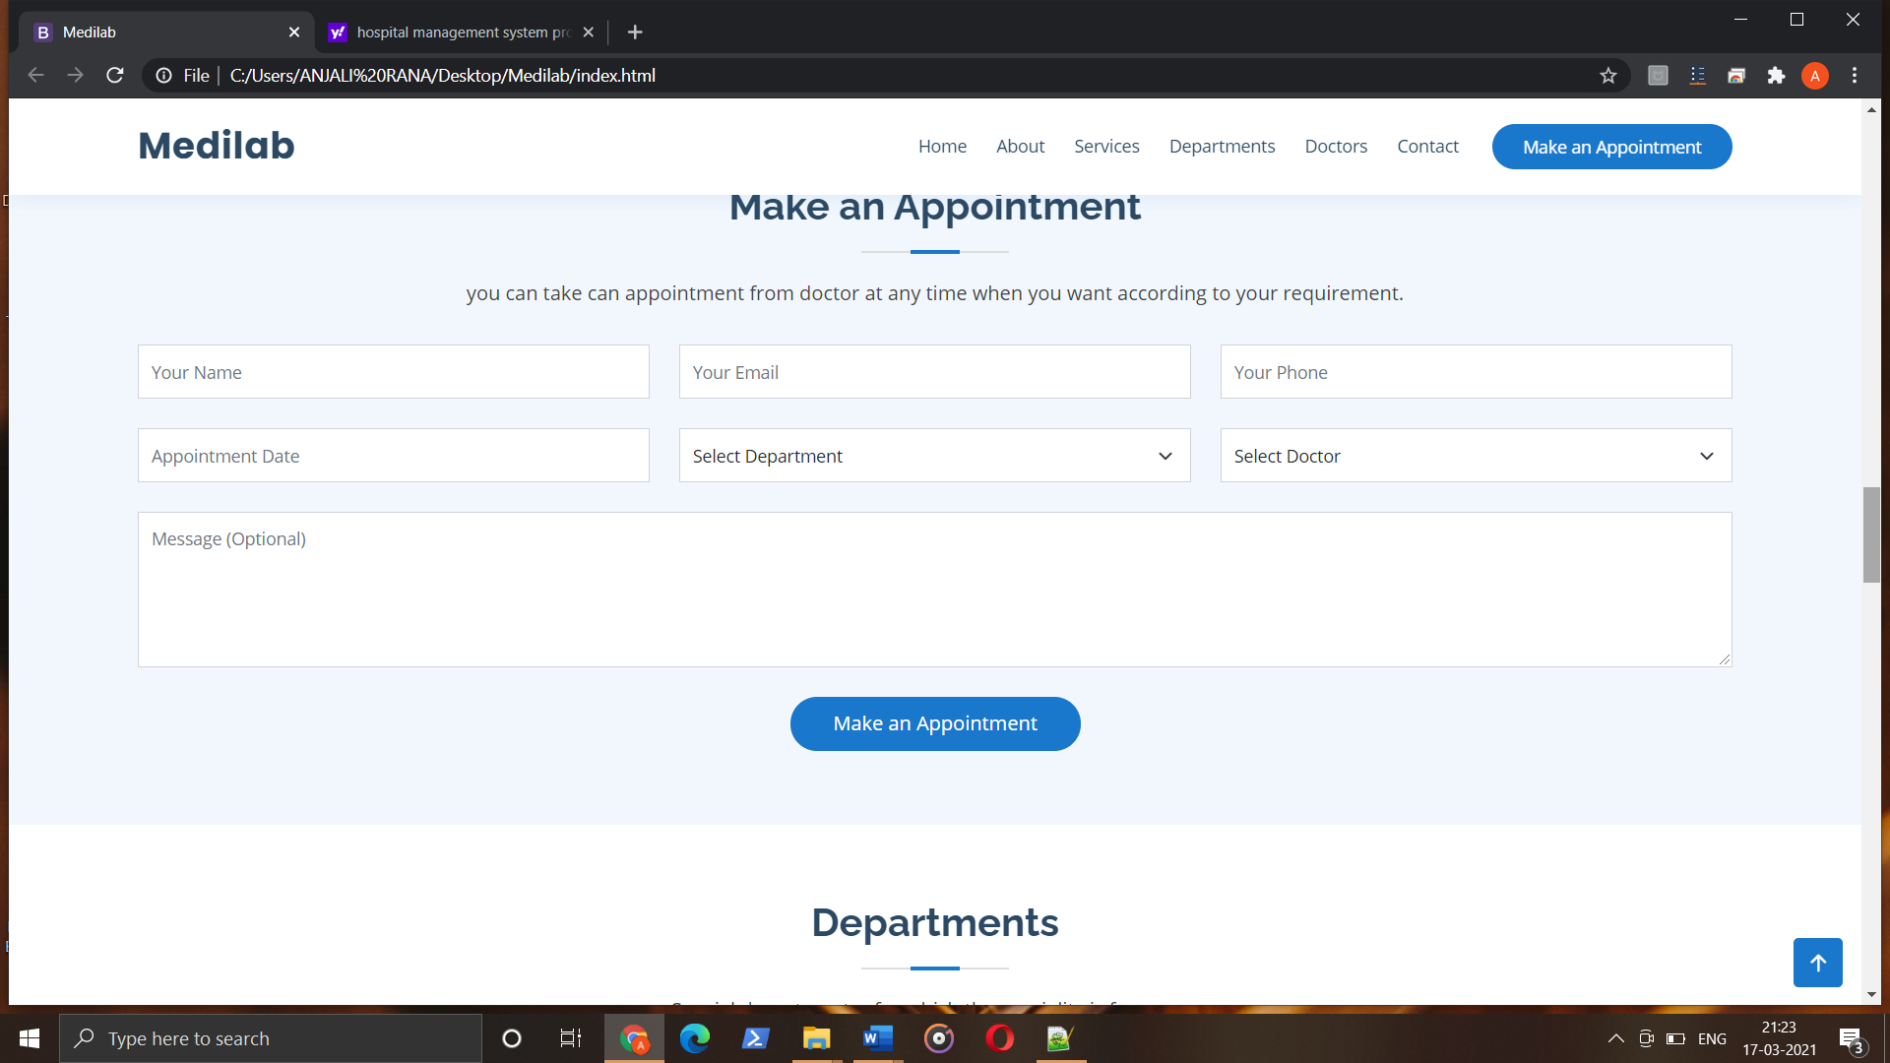

Slide 16
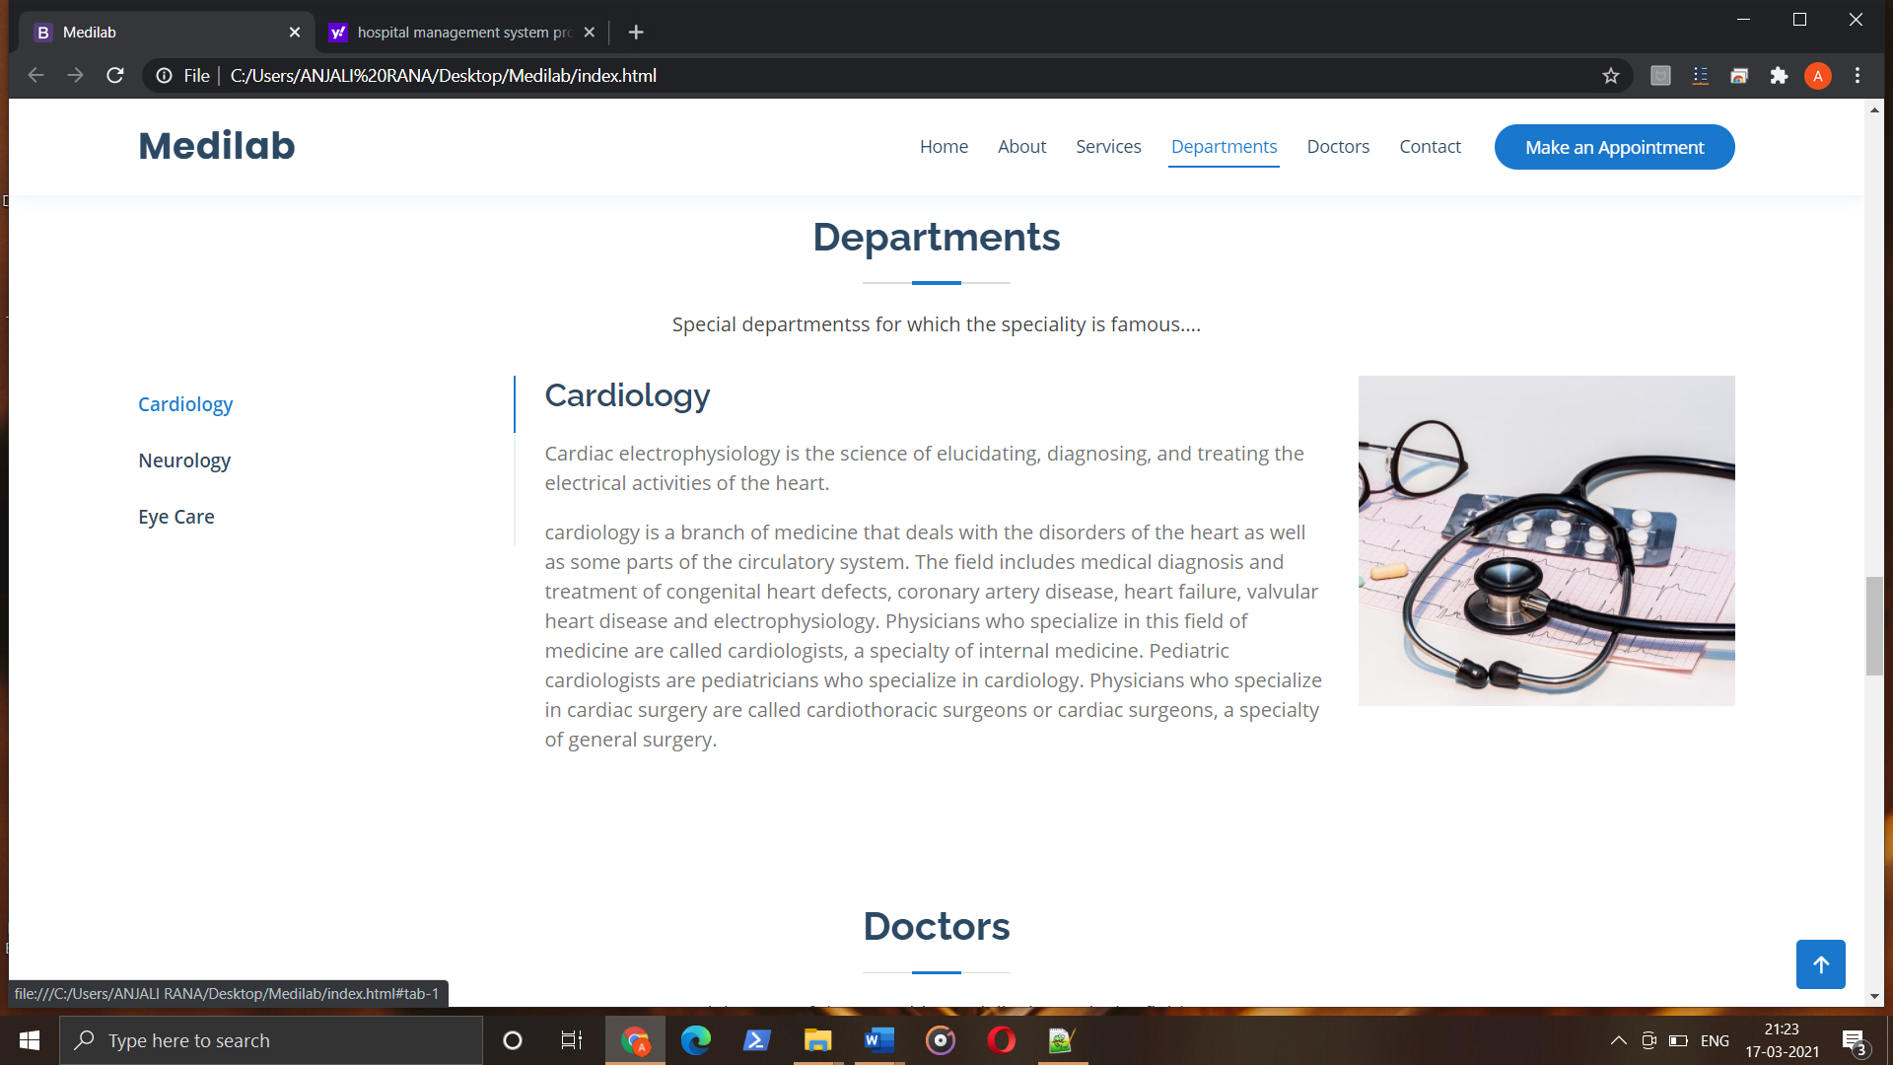

Slide 17
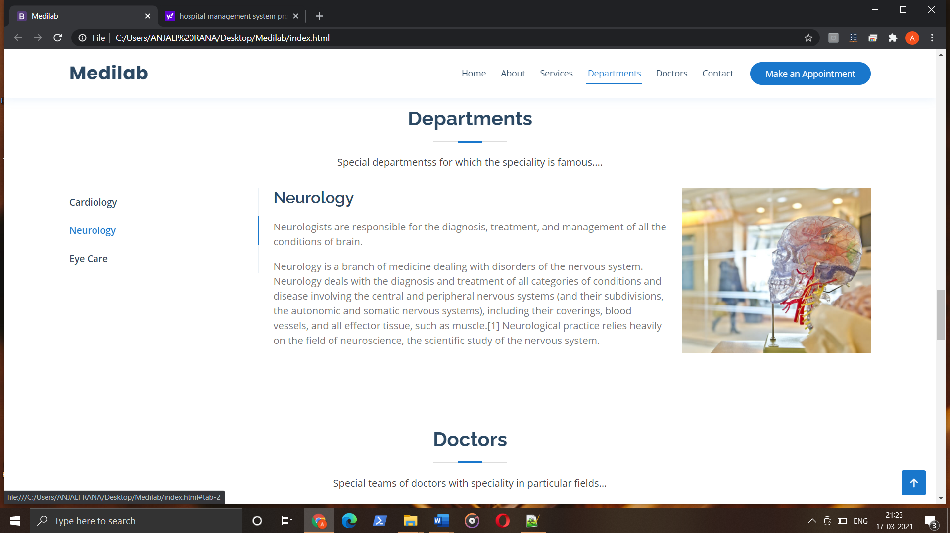

Slide 18
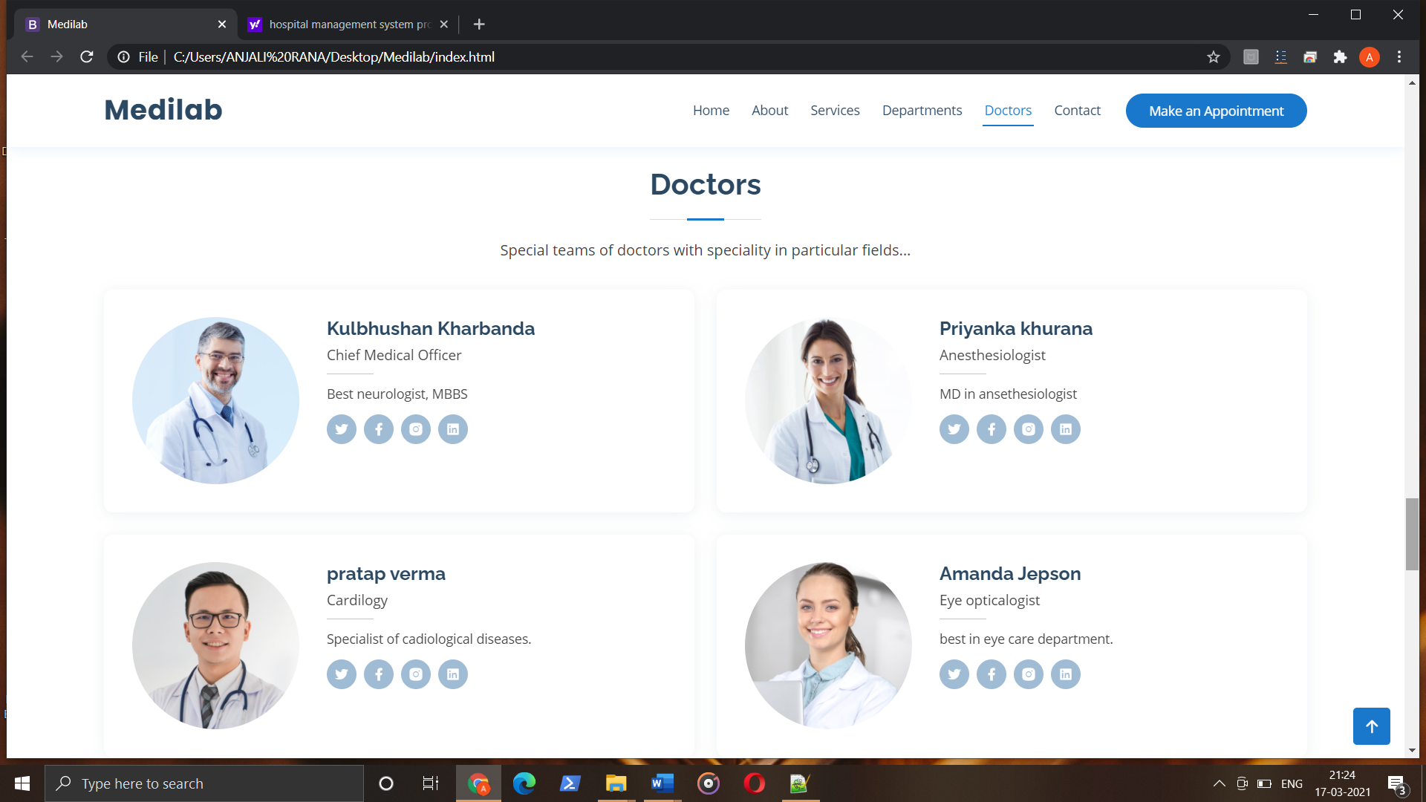

Slide 19
Conclusion:
The project is of web designing using Html, Css, Bootstrap and JavaScript for frontend. The purpose of designing this website to is provide the online
Appointment for doctors and treatment. Patients can directly contact and make queries about your treatment and appointment for the availability of doctors. Patients can check the various services provided by the heath care center. The health care center provides the various department services like specialty in cardiology, neurology and eye care.
The project main aim is providing the online services to the patients so that they can easily take the appointment from specialist doctors and get rid from their diseases very easily in less time and it also saves the time.
Health care gallery is also present in website.

Slide 20
THANK YOU

